Slide 1
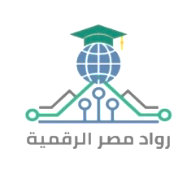

Digital Marketing Specialist
Graduation Project
Group: YAT458A_ALX2_DRT1_S1
Supervised by: Moemen El Badri
Submitted by:
Rewaa Ahmed Mohamed Harraz (Content strategist, Editor)
Rahma youssef salah eldin (Content strategist)
Nada Mohi Eldeen Ali (Content design, Editor)
Amr Aly Abdel Aziz Mohamed Kotb )Video Editor, STP Developer)
Amr Khaled abdel Mohsen (Market research)
Abdelrahman Ahmed Saeed

Slide 2
01
Introduction

Slide 3
Vision
To be the go-to solution for individuals seeking innovative and simple ways to prepare healthy and delicious meals using the ingredients they have, creating joyful and fulfilling food experiences in their daily lives

Slide 4
Mission
To offer innovative and easy-to-follow recipes that enhance users meal experiences, utilizing only the ingredients they have, ensuring health and variety, and bringing happiness and comfort to every meal through personalized food solutions

Slide 5



Direct Competitors
Wanna Cook
Eater_meals
Strengths | Weaknesses
Available in Arabic | Doesn’t give exact tailored recipes
Available on Google Play | Too many ads in user interface
Distinctive visual identity | No specific dates for updates
Split meals for children and healthy meals for two people
Available drinks and desserts
Variety of cultural food
Easily add ingredients
Strengths | Weaknesses
Visually appealing food photos | Available in English only
Clear and catchy brand message | No detailed nutritional information
Engaging short videos (reels) | Content lacks variety—mostly focused on product shots
 | Few behind-the-scenes or personal storytelling elements
Strengths | Weaknesses
Available in Arabic | There is no way to prepare the food
Product quantity, purchase date and expiration date | Uncomfortable interface for users
Make a shopping list | Not available on Google Play

Slide 6


Direct Competitors
Indirect competitors
Strengths | Weaknesses
Versatile and can answer a wide range of topics | Not specialized in cooking or food content
Fast, text-based responses | No visual meal outputs or taste-based logic
Excellent for idea generation and content writing | Requires user prompts—doesn't guide cooking interactively
Strengths | Weaknesses
Provides short engaging videos demonstrating cooking steps | Not available in Arabic
Filter recipes by food type | Doesn’t offer the feature of adding available components
Make a shopping list | Inclusion of readily unavailable ingredients

Slide 7



Alternative Services
Google assistant | Talabat | Youtube
Provides recipes based on user inquiries | Delivers food when the user is unable to prepare a meal | Contains rich, searchable cooking content.

Slide 8
SWOT Analysis
Strengths
Weaknesses
Providing recipes based on the client's ingredients and tools specifically.
Can request missing components from delivery orders Smart fridge notifies your phone when items are running low.
Tracks calories based on your weight and goal, like a personal nutrition coach.
S
W
Limited budget
Lack of a programmer in the team
Poor time Management
O
T
Threats
Opportunities
Economic Changes
Rising Costs of Technical Services
Rapid Technological Developments
Competitors analyzed to determine added value. Create strong social media content.
There is a real need for the idea.

Slide 9
02
Business Canvas Model (BCM)

Slide 10
BCM
Key Partners
Key Activities
Value Proposition
Customer Relationships
Customer Segments
Channels
Key Resources
Cost Structure
Revenue Streams

Slide 11
BCM
Key Activities
Value Proposition
Customer Segments
Development and continuous training of the AI bot
Integration with databases for updated recipe content
Marketing and customer acquisition campaigns
Managing partnerships and business development
Regular updates based on user feedback and technological advancements
Personalized and instant recipe suggestions based on user preferences, available ingredients, and dietary needs
Reduces meal planning time and food waste
Accessible 24/7 through multiple digital platforms (mobile, web, social media)
Offers a seamless, fun, and interactive cooking experience
Busy professionals seeking quick meal ideas
Students looking for easy, affordable recipes
Fitness enthusiasts requiring customized meal plans
Families needing efficient meal planning solutions
Home cooks interested in discovering new recipes

Slide 12
BCM
Channels
Revenue Streams
Mobile application (iOS & Android)
Website platform
Social media platforms (Instagram, TikTok, Facebook Messenger)
Email newsletters with curated recipe collections
Partnerships with grocery delivery services and e-commerce platforms
Freemium model: free basic features with premium subscription plans for advanced services (meal planning, nutrition tracking)
In-app advertisements and sponsored recipes
Affiliate marketing with grocery delivery and kitchen equipment companies
Selling data insights (in compliance with privacy regulations) for food brands and market researchers

Slide 13
Segmentation, Targeting, Positioning (STP)
Segmentation
Busy Professionals
Demographics: 25-40 years, middle-high income, urban sectors (tech, finance)
Behavioral: Frequent users of Talabat, active on Instagram, WhatsApp
Students
Demographics: 18-25 years, university students, low income
Behavioral: Heavy TikTok/Instagram users, shares content
Fitness Enthusiasts
Demographics: 20-35 years, moderate income, gym-goers
Behavioral: Tracks calories, follows fitness influencers
Families
Demographics: 30-45 years, parents, moderate income
Behavioral: Plans meals, grocery delivery users, Facebook active
Targeting
Positioning
Targeting prioritizes segments based on size, profitability, and alignment with iChef's strengths.
Primary Targets:
Busy Professionals: High demand for quick recipes, income for premium, strong urban presence.
Fitness Enthusiasts: Needs calorie tracking & personalized meal plans.
Secondary Targets:
Students: Fits freemium model and drives TikTok virality.
Families: Needs meal planning support and ideal for grocery affiliate revenue.
iChef differentiates through Arabic flavor, user-friendly design, smart tech, and affordability.
Positioning Statement: "For busy professionals and fitness enthusiasts in Egypt who need quick, healthy, and budget-friendly meals, iChef is the AI-powered cooking assistant that delivers personalized Arabic recipes based on your ingredients and goals, offering a seamless, engaging experience on your phone."
Key Differentiators: - Arabic & Local Flavor - Seamless User Experience - Smart Technology - Community Focus - Affordable Accessibility

Slide 14
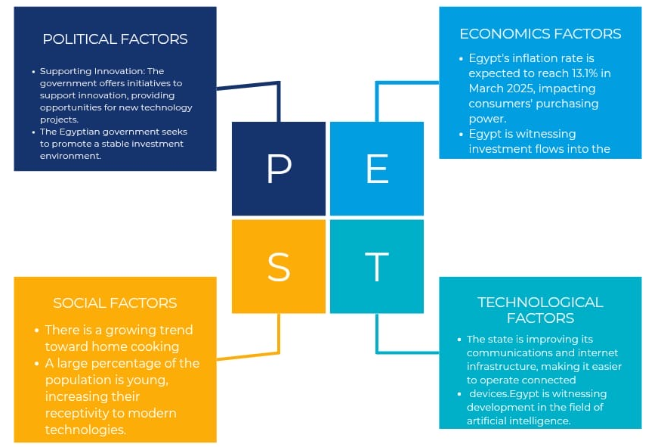
PEST Analysis

Slide 15
Content Strategy
Facebook, Instagram, and LinkedIn Digital Marketing Strategy

Slide 16
Content Plan
Primary Objectives
Brand Awareness: Position I-Chef as an innovative and valuable resource for food lovers.
Community Building: Establish a strong, interactive audience that trusts the brand.
Thought Leadership: Showcase expertise in food-tech to attract investors, media, and key industry players.
Pre-Launch Engagement: Build anticipation so that when the app is launched, there is already demand.
Content Monetization Potential: Prepare for future monetization through sponsorships, partnerships, and premium content.

Slide 17
FACEBOOK MARKETING STRATEGY
https://www.facebook.com/share/19tMvru44h/?mibextid=wwXIfr

Slide 18
Facebook Marketing Strategy
Primary Audience:
Busy professionals & parents looking for quick, creative meal ideas
Food enthusiasts who love experimenting with new recipes
Young adults interested in trendy, budget-friendly cooking
Health-conscious individuals looking for nutritional insights
Key Content Themes
Storytelling (Emotional Connection)
Educational Content (Authority & Value)
Interactive & Community-Driven Content
Behind-the-Scenes (Brand Transparency & Trust)

Slide 19
Facebook 1-Month Content Calendar Sample
Week | Monday (Storytelling & Education) | Wednesday (Community & Interactive) | Friday (Live & Video Content) | Sunday (Growth & Viral Content)
Week 1 | How I-Chef Was Born: The story behind the idea & its vision | Poll: "What’s your biggest cooking struggle?" (e.g., time, creativity, health) | Live Session: Meet the team – answering questions about I-Chef | Trending Recipe Challenge: “Try this dish & tag us!”
Week 2 | Relatable Problem: “How many times have you asked ‘What should I cook today?’” (Engagement Post) | Quiz: "What’s your cooking personality?" (Casual, experimental, gourmet?) | Live Cooking Demo: A chef makes a dish with audience suggestions | User-Generated Content: Reposting best dishes from followers
Week 3 | Behind the Scenes: “Here’s what we’re working on for I-Chef’s future” | Debate Post: "Team Sweet vs. Team Spicy – which do you prefer?" | Live AMA (Ask Me Anything): "Everything you want to know about AI in cooking" | Feature a food influencer trying out an I-Chef concept
Week 4 | Success Story: “Meet Sara, a working mom who struggles with meal planning” | Community Post: “What’s the best cooking hack you’ve ever learned?” | Live Collab with a Chef: "Quick & easy dinner ideas" | Cooking Meme or Fun Fact (Engagement Post)
Facebook Advertising Strategy
Goal: Drive awareness and engagement Best Ad Types:
Video Ads → Show how I-Chef solves problems
Engagement Ads → Boost interaction & community growth
Lead Generation Ads → Collect emails for early app access
Targeting Strategy: Interest-based targeting: Food lovers, home cooks, working professionals Lookalike Audiences: People similar to engaged followers

Slide 20
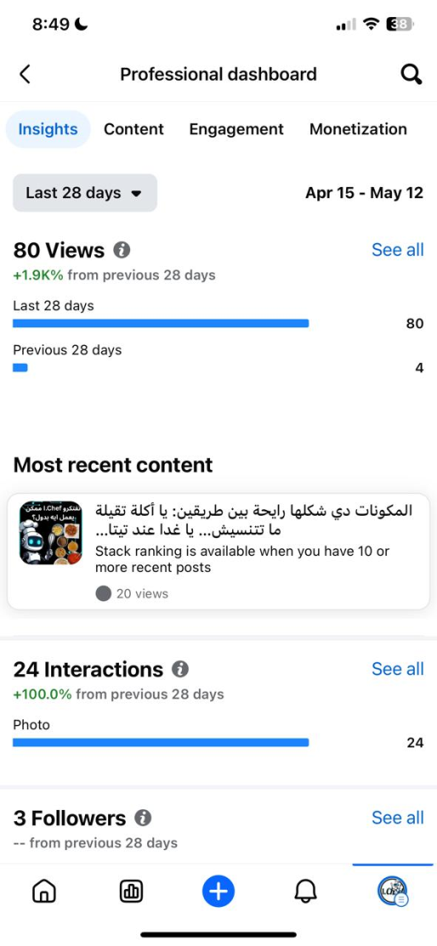
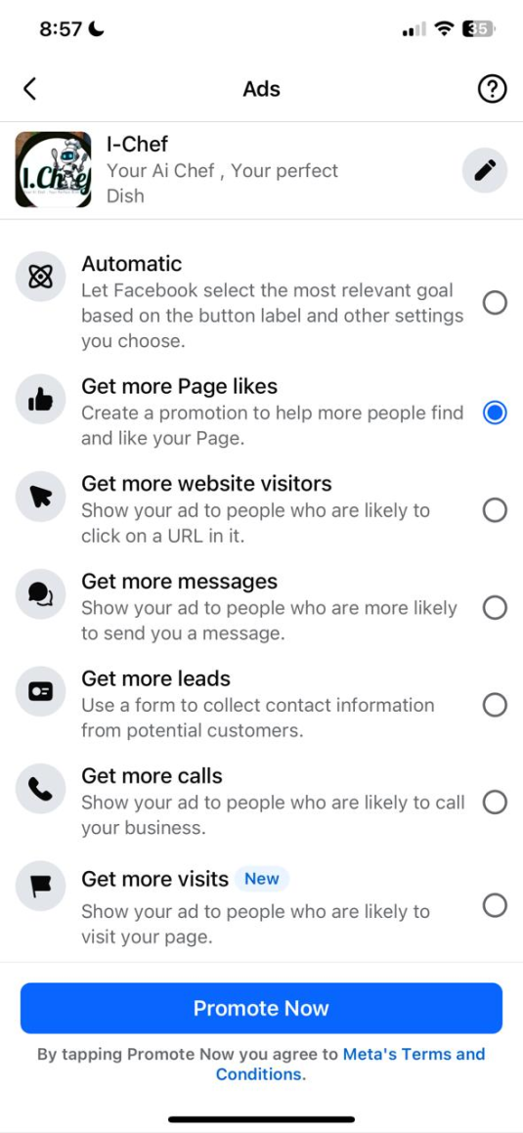
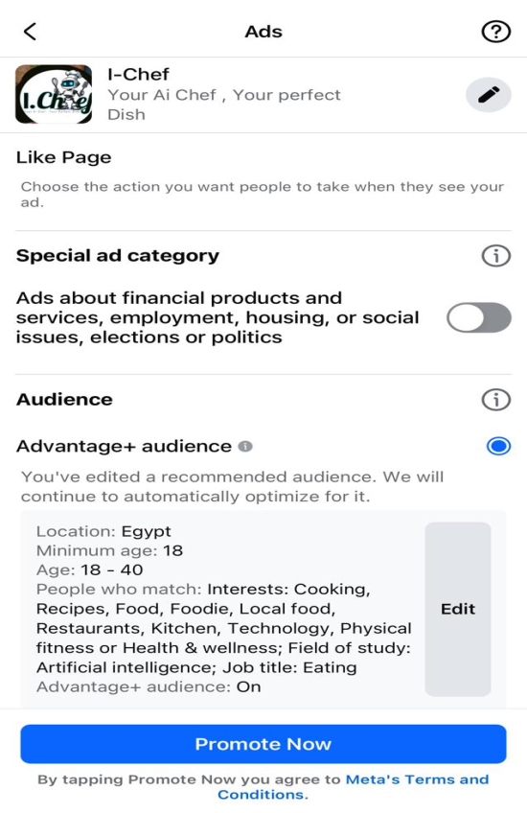

Slide 21
Linkedin MARKETING STRATEGY
https://www.linkedin.com/company/ichef2025/

Slide 22
Linkedin Marketing Strategy
Primary Audience:
Tech investors & startup enthusiasts looking for innovation in food-tech.
Food industry professionals interested in AI’s impact on the culinary world.
Key Content Themes
Thought Leadership Articles
Industry Trends & Research-Based Content
Founders’ Personal Branding (Humanizing the Brand)
Networking & Partnerships

Slide 23
LinkedIn 1-Month Content Calendar Sample
Week | Tuesday | Thursday
1 | The Future of AI in FoodTech: How Smart Cooking is Evolving | Founder’s Journey: "Why We Started I-Chef"
2 | Industry Report: "The Future of AI in Cooking" | Case Study: How AI is Used in Global Kitchens
3 | Behind-the-Scenes: How we’re developing I-Chef | Founder’s Story: The challenges of building I-Chef
4 | Infographic: The biggest food-tech trends in 2024 | Open Discussion: “What’s one kitchen innovation you wish existed?”
By the end of this 1-month plan, I-Chef will have: ✔ A highly engaged audience excited for the launch ✔ Established authority in the food-tech industry ✔ Potential investors, partners, and early adopters

Slide 24
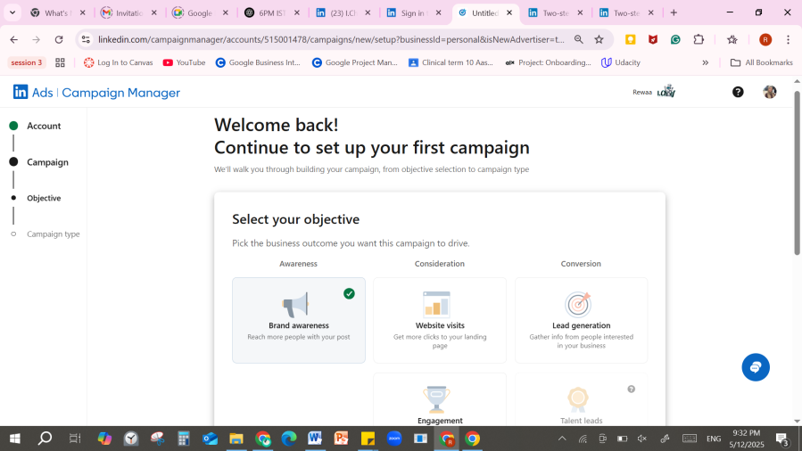
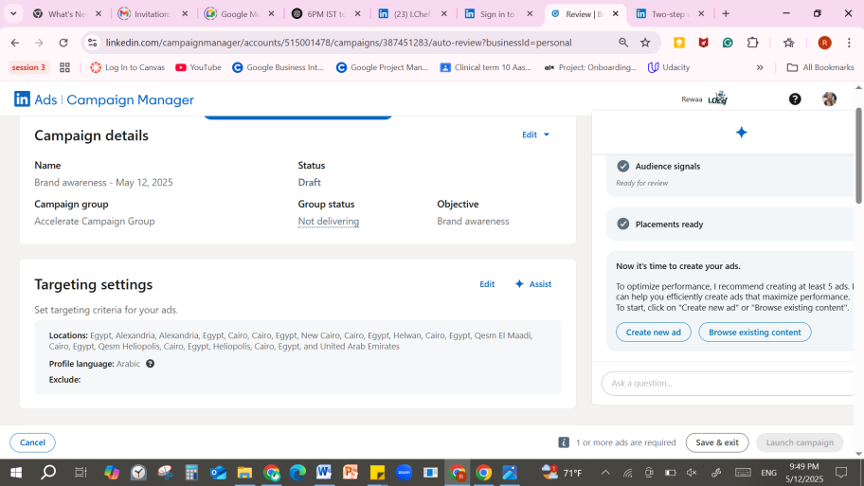
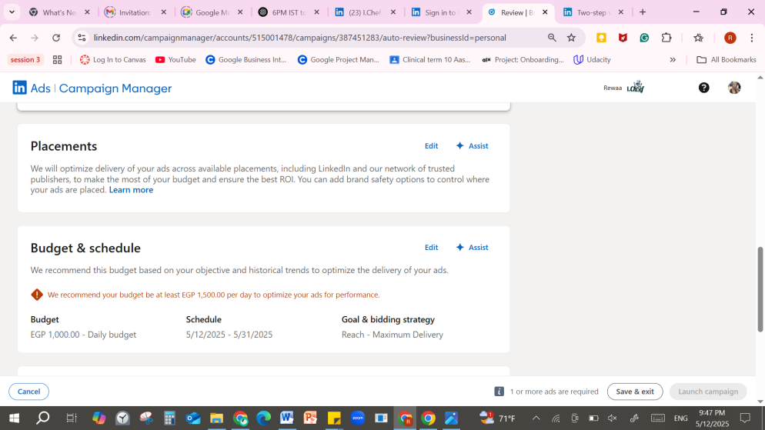

Slide 25
MARKETING STRATEGY
Instagram
https://www.instagram.com/ichef2025?igsh=ajFvOGFobXFoNGtl&utm_source=qr

Slide 26
Instagram Marketing Strategy
Key Themes:
Showcasing AI-Driven Recipe Innovations:
Creative Recipe Creations
Collaborations with Famous Egyptian Chefs:
User feedback & Content Recycling:
Content Formats:
Feed Posts: Static posts, carousels, reels, and IGTV sessions (3 times per week).
Stories: Daily behind-the-scenes, polls, Q&As, and interactive elements.
Language: All captions and on-screen text in local Arabic with culturally relevant hashtags.

Slide 27
Instagram 1-Month Content Calendar Sample
Week | Day | Content type & Details | Stories (Additional Engagement)
1 | Monday | poster: logo and app teaser | rhetorical question about the app
 | Wednesday | reel: launching the app | check out the latest reel
 | Friday | reel: Content recycling and stitch | meal prep difficulties
2 | Monday | Tutorial AI feature & recipe showcase | Quick tutorials; BTS snaps of recipe creation; interactive poll.
 | Wednesday | Content Recycling with Local Twist. | Snippets from original posts with added commentary; opinion poll.
 | Friday | poster: Behind-the-scenes team vibe | Team snapshots; mini-interviews; candid moments.
3 | Monday | poster: fanbase suggestion | Teasers from the collaboration; BTS prep clips; “Ask the Chef”.
 | Wednesday | memes | Quick facts about local trends; interactive quizzes; polls.
 | Friday | Recap & Call-to-Action. | Recap stories; thank-you messages; final poll/Q&A.
4 | Monday | Poster: “Meet the Tech Behind I-Chef” | Tech trivia quiz; feature the dev team; “Guess what’s coming next?”
 | Wednesday | Reel: User Reactions & First Impressions | Poll: “Would you try I-Chef?”; fan shoutouts; reaction stickers
 | Friday | “Create a Meal Plan with I-Chef in 60 Seconds” | Swipe tutorial series; Q&A box; countdown to next update

Slide 28
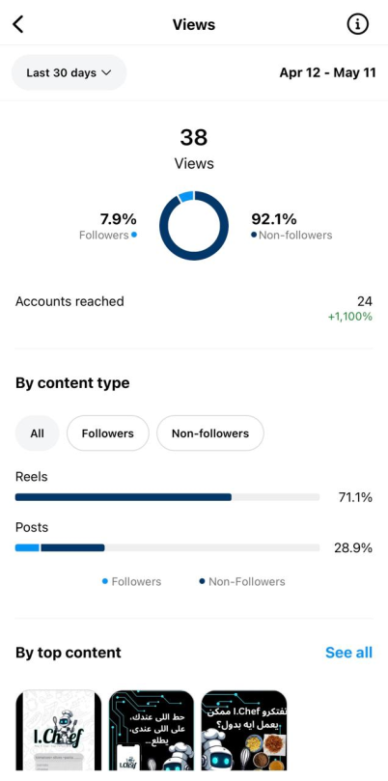
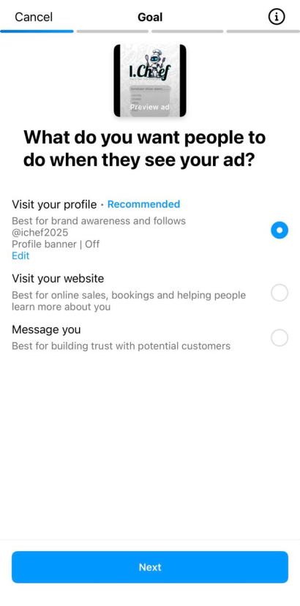
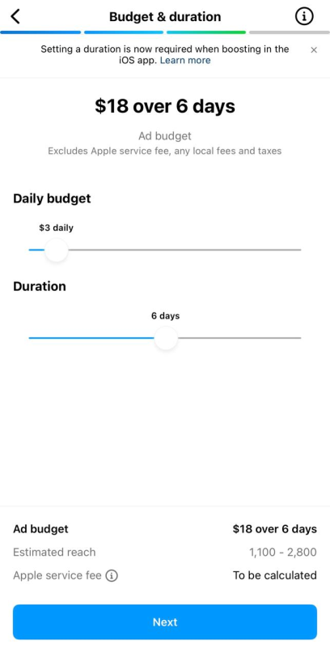
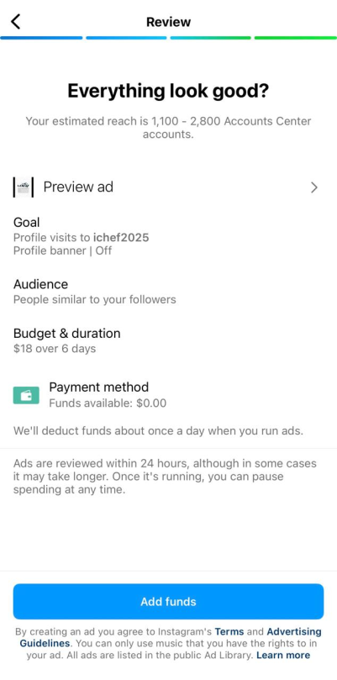

Slide 29
YouTube MARKETING STRATEGY
YouTube channel is a long term plan. It will be created after building a fan base to post blogs, behind the scenes and possibly podcasts with figures in related fields.

Slide 30

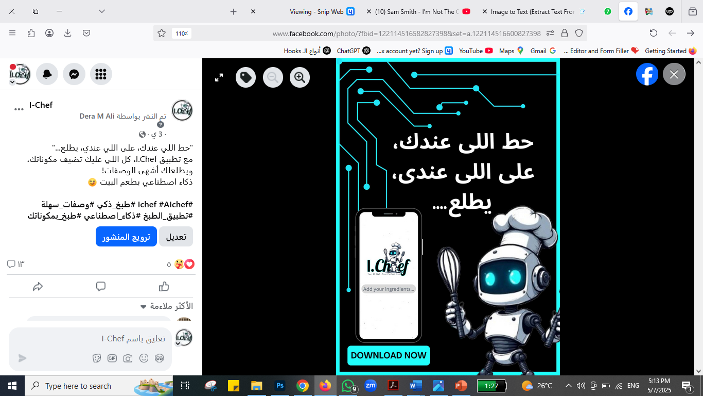
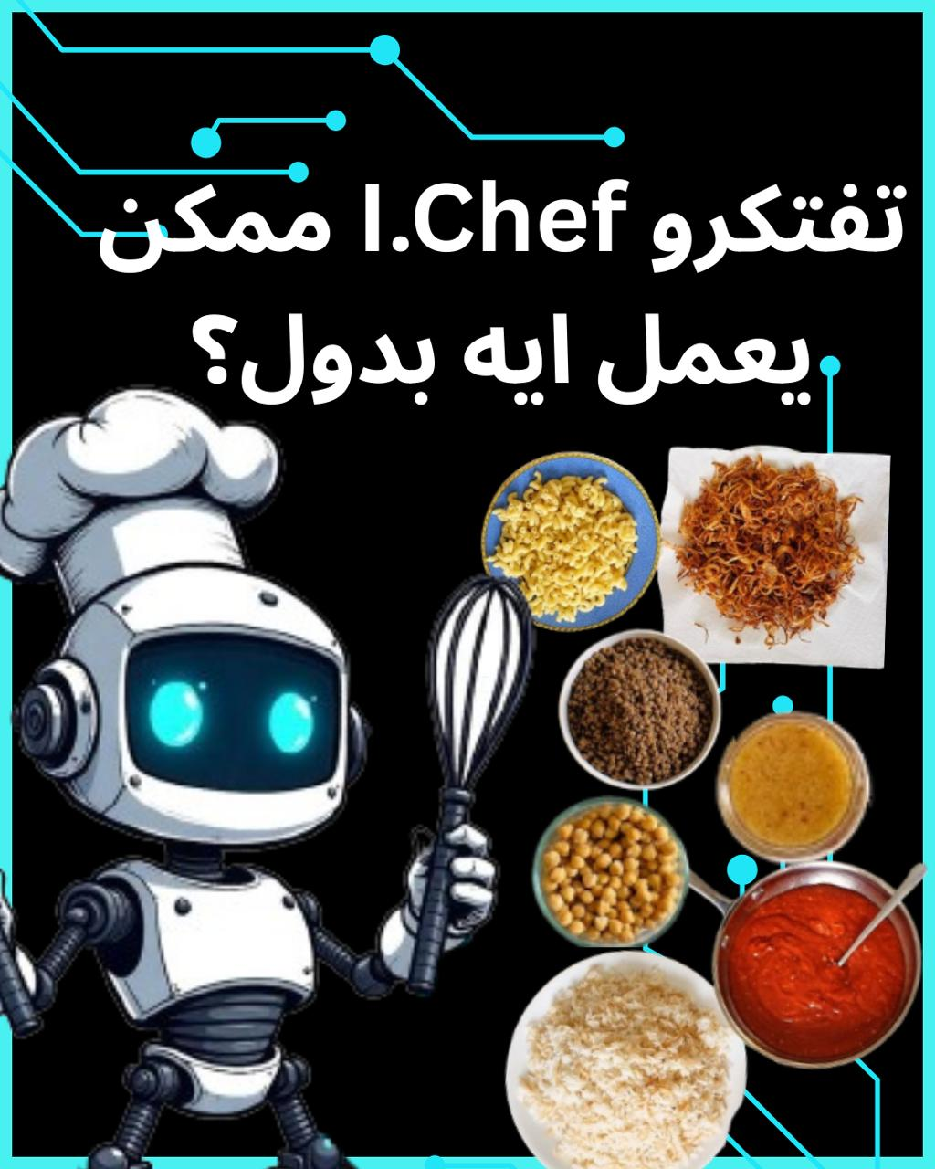
"حط اللي عندك، على اللي عندي، يطلع..." مع تطبيق I.Chef، كل اللي عليك تضيف مكوناتك، ويطلعلك أشهى الوصفات! ذكاء اصطناعي بطعم البيت #Ichef #AIchef #طبخ_ذكي #وصفات_سهلة #تطبيق_الطبخ #ذكاء_اصطناعي #طبخ_بمكوناتك
المكونات دي شكلها رايحة بين طريقين: يا أكلة تقيلة
ما تتنسيش… يا غدا عند تيتا
‏‎تفتكروا هتكون إيه؟ شاركونا توقعاتكم
Sample

Slide 31
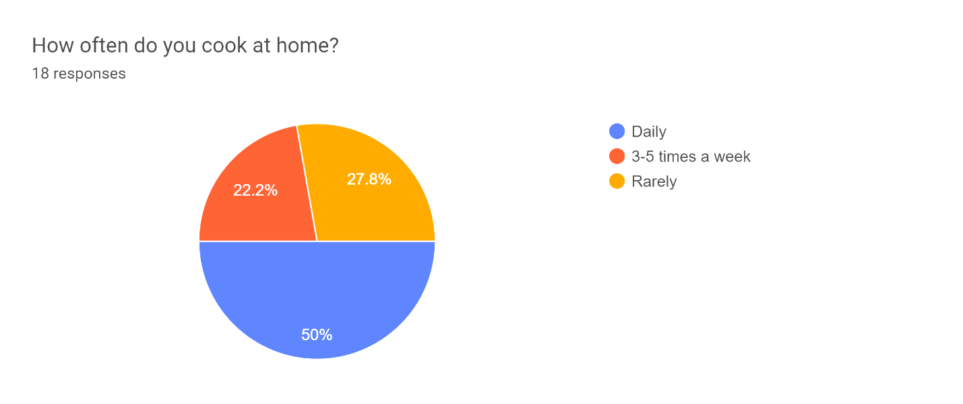
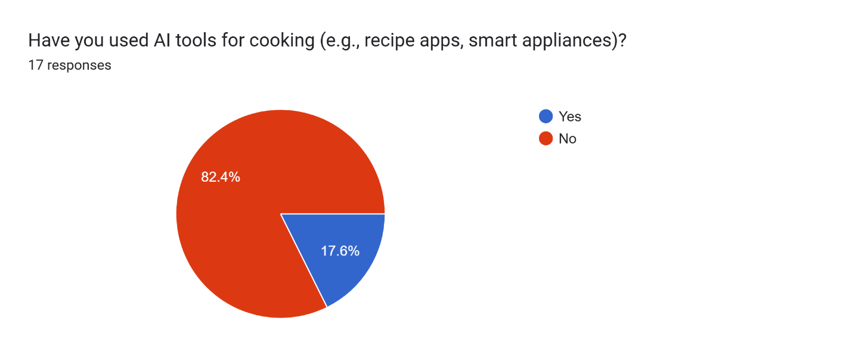
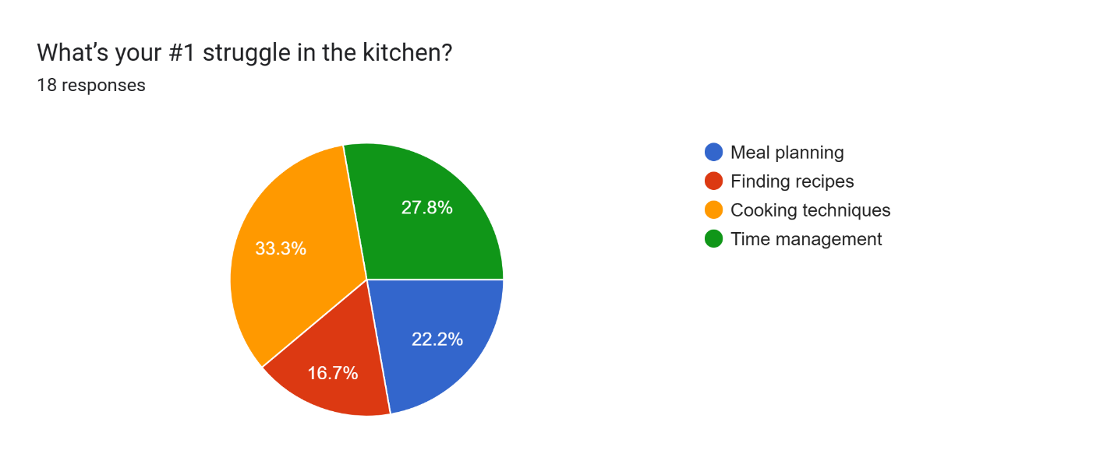
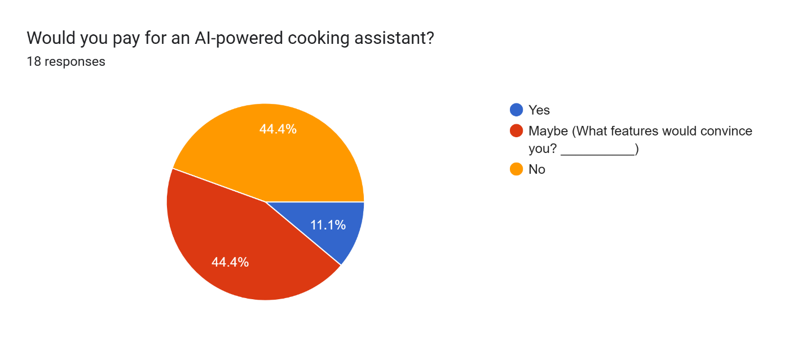
Survey

Slide 32
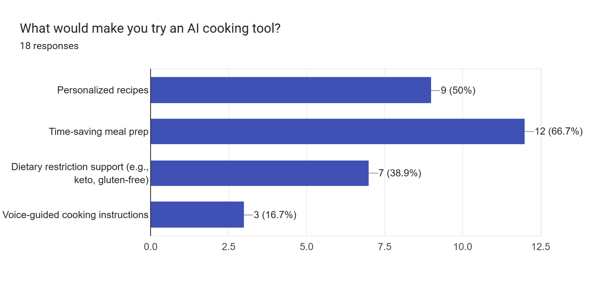
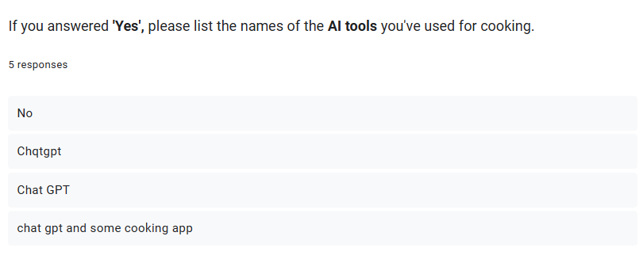
Survey

Slide 33
THANK YOU!

